Slide 1
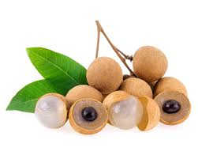
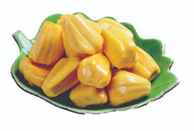
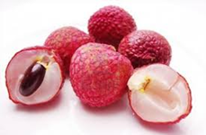
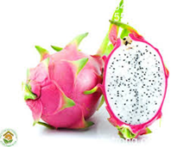
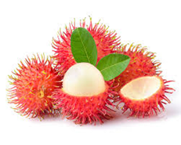
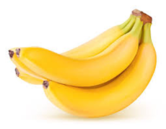
SUNRISE AGRICULTURE IMPOR – EXPORT COMPANY LIMITED (SUNRISE AIE CO LTD) ADD: NO. 157 YEN LANG, HA NOI CAPITAL, VIET NAM EMAIL: AGRIFOODVN@GMAIL.COM
INTRODUCTION ABOUT COMPANY
Hà Nội, Date 16 Aug , 2021 Year

Slide 2
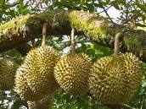
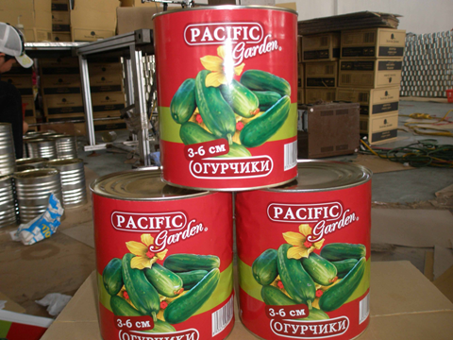
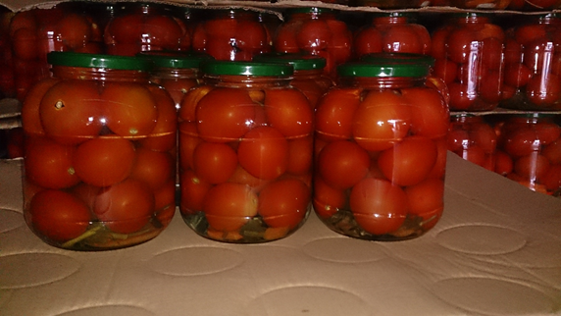
BRIEF ABOUT US
We are a Leading company to export all kind of fruit and vegetable at Vietnam.
Establish on 2020 Years. But before we export fruit and vegetable more 14 years.
Main products: Canned pineapple, Cucumber In jar, Fresh and frozen fruit and vegetables as fresh lychee, longan….

Slide 3
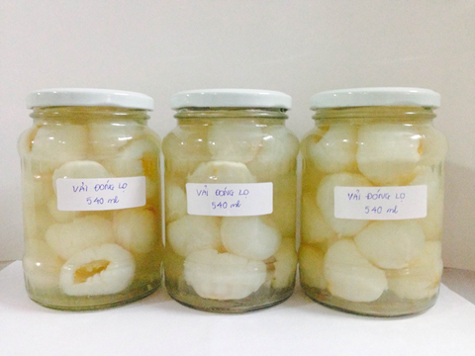
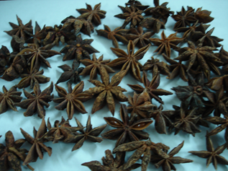
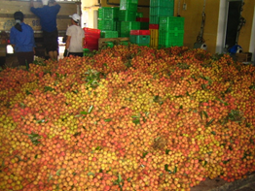
INFORMATION ABOUT PRODUCTS: 1. Processing products: Canned pineapple, canned lychee, , canned longan, canned sweet corn, baby corn…. 2. Frozen fruit and vegetabels: IQF pineaple, lychee, passion fruit juice, dragon,.. 3. fresh fruit and vegetables: fresh lychee, long an, hot chilly pepper. 4. Spices: Black pepper 550gr, 500gr, cassia, star aniseed.
Fresh lychee
Lychee in Jar
Star aniseed

Slide 4
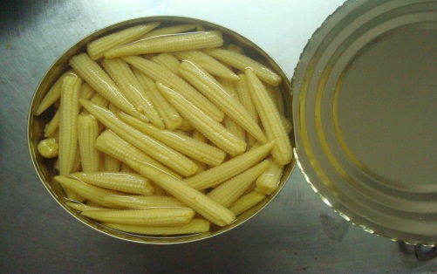
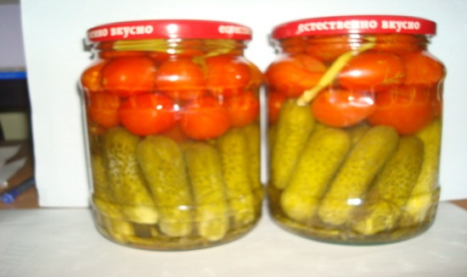
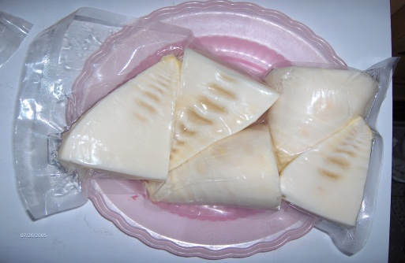
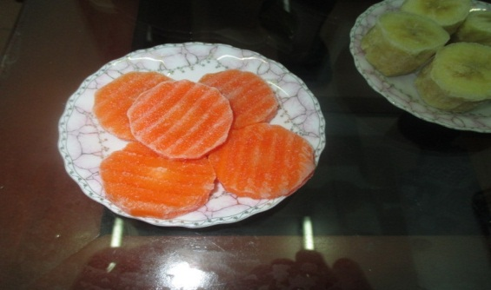
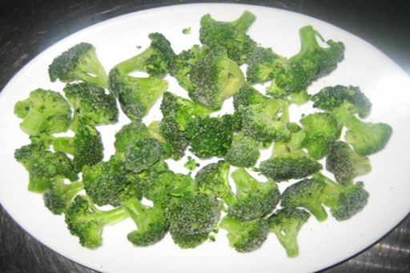
SOME PRODUCTS OF COMPANY
Baby tomato
Baby corn
Mixed tomato and Cucumber
Frozen Bamboo
IQF carrot
Frozen Brocolli

Slide 5
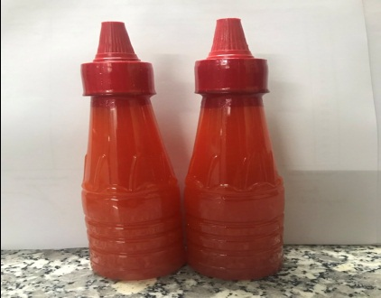
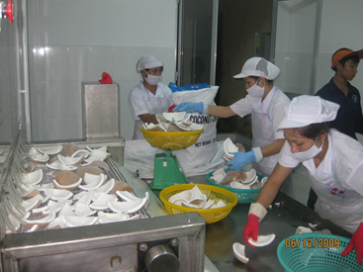
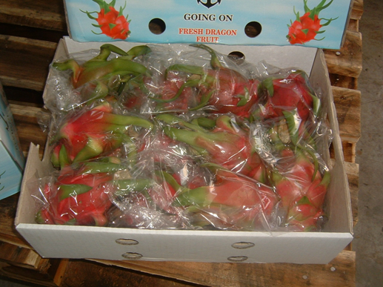
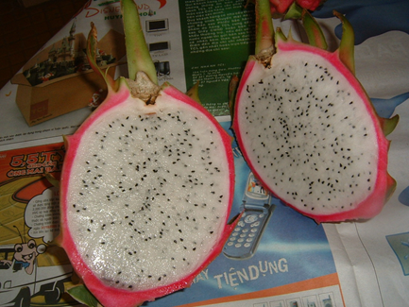
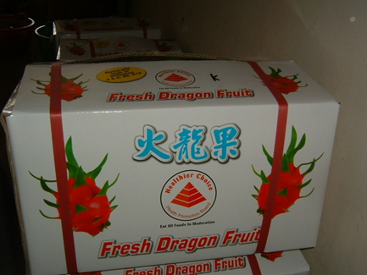
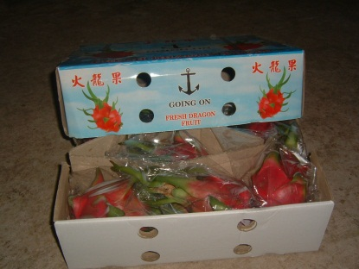
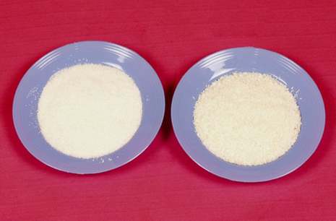
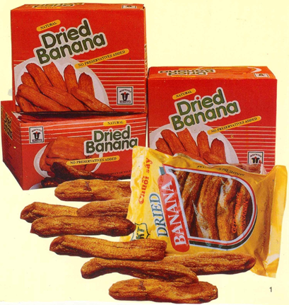
Passion fruit paste
Chilly sauce
Frozen mango
Fresh rambutan
Fresh dragon
Fresh dragon
Desicated coconut
Dry bananas

Slide 6
Thank you

