Slide 1
BUSINESS INTRODUCTION LETTER
Oct 2021

Slide 2
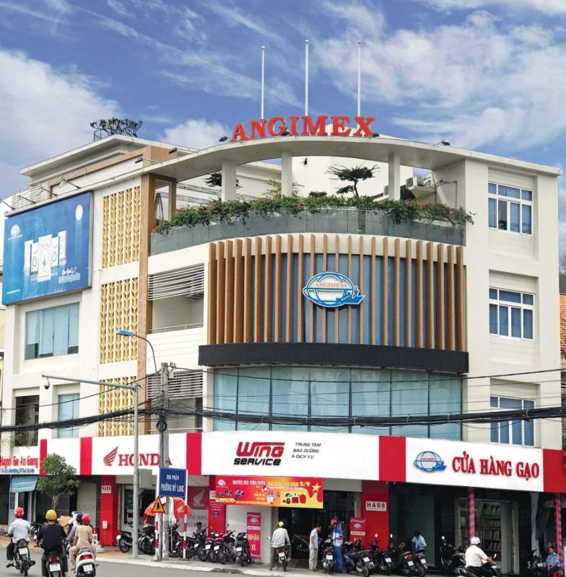
An Giang Import Export Joint Stock Company
Angimex
1976
Established
Equitized
2008
2012
Listed
Subsidiaries established
2020
Authorized capital
182
Address: 01 Ngo Gia Tu, Long Xuyen City, An Giang

Slide 3
Outstanding Achievements
Top 1,000 enterprise of tax contribution
Top 500 largest enterprises in Vietnam
Reliable Exporters – Ministry of Industry and Trade of Vietnam
Vietnamese High quality goods voted by consumers

Slide 4
Our development strategies
Trusted production and trading of rice: Connect with farmers to produce rice that meet European quality standards; organic rice,…
Agricultural materials: trading organic fertilizers, micro-organic fertilizers and rice seeds in the direction of clean agriculture
Trading services: trading in automobiles, motorcycles and spare parts in An Giang and neighboring provinces

Slide 5
Main business of Subsidiaries
Rice Industry
Angimex Food Co Ltd.,
1
Trade - Service
Angimex Furious Co Ltd.,
2
Agriculture Materials
Dasco Co Ltd.,
3

Slide 6
Vision
Angimex orients to become a leading agricultural corporation in Vietnam, constantly learns, innovates and invents to create a high–tech and sustainable agricultural ecosystem.
Mission
Angimex always accompanies farmers to improve the quality of Vietnamese agricultural products and enhance the position of Vietnamese agriculture in the international arena.
Core Values
Angimex always puts the word " PRESTIGE – CONSCIENCE – INTELLECT " on the top position in business activities, considers PRESTIGE as a competitive weapon, CONSCIENCE as the foundation, INTELLIGENCE as the vitality.

Slide 7
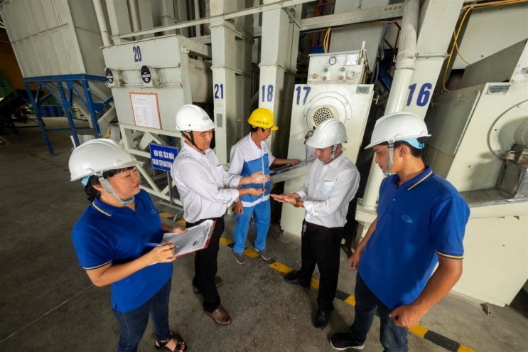
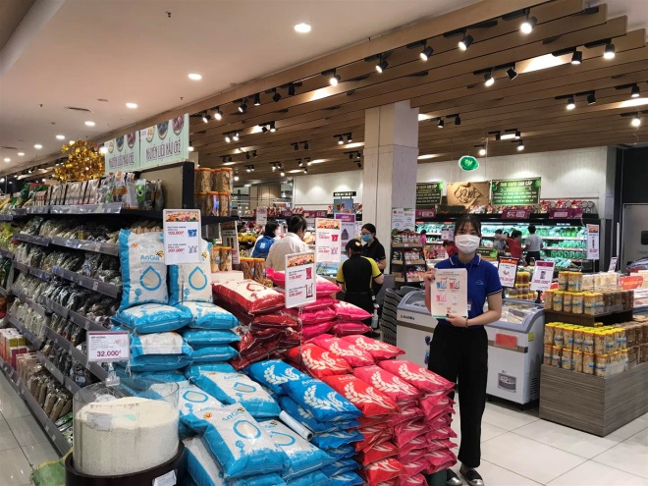
Rice Industry
1
Export
2
Domestic

Slide 8
Competing Capability
30TONS/HOUR DRY CAPACITY | 2.200TONS/DAY MILLING AND PRODUCTION CAPACITY | 200.000+TONS STORAGE CAPACITY

Slide 9
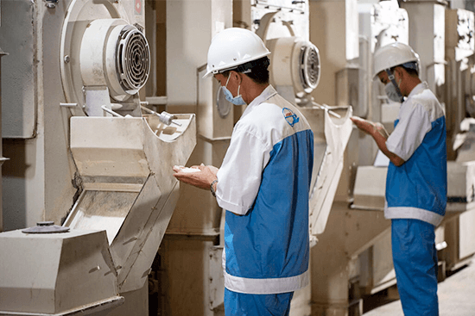
Competing Capability
We invested in advanced equipment such as: metal detectors, automatic bag counting dosing machines, the 6-sided vacuum bagging machines, etc. The product quality control management department met international standards fully equipped with the following equipment: whiteness meter, amylose meter, humidity meter, broken rice degree analysis equipment, martial peeling machine, mini whitening machine, etc. Angimex is proud to be an enterprise that uses advanced equipment in rice production for domestic and overseas markets.
PRODUCTION LINE, STORAGE

Slide 10
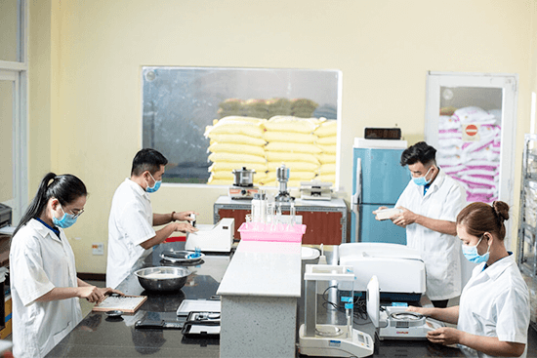
Competing Capability
We had modern technology laboratory to study rice condition. In addition, there is also a sample room to analyze the format, taste, smell and color of rice to develop strong quality provided to customers.
QUALITY CONTROL

Slide 11
Raw Material Area
We help farmers produce sustainably, synchronously apply technical solutions to improve productivity and quality, incomes. We also sent a team of technical staff who accompany the farmers to visit rice fields regularly, consult on production techniques as well as worn and pests prevention in rice fields, to ensure the growth of rice plants in the best condition. This makes stabilize the quantity and quality of sources that meet Europe standards for all our products. We are proud of as one of the biggest Vietnamese rice exporter to Europe in last years.

Slide 12
Quality Certificate

Slide 13
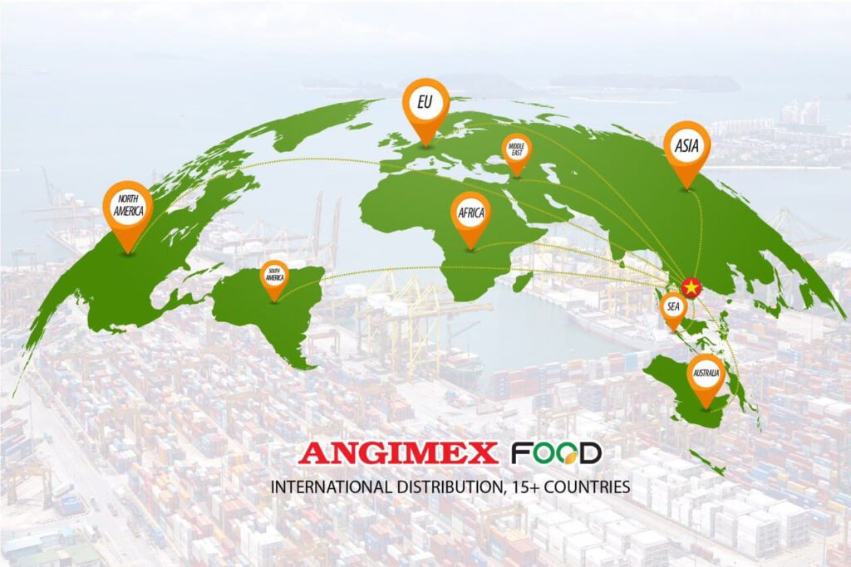
International Markets
Annual export:
200.000 – 250.000 TONS Export markets: Europe, Singapore, Hong Kong, Middle East, Philippines, Malaysia, Africa, USA…

Slide 14
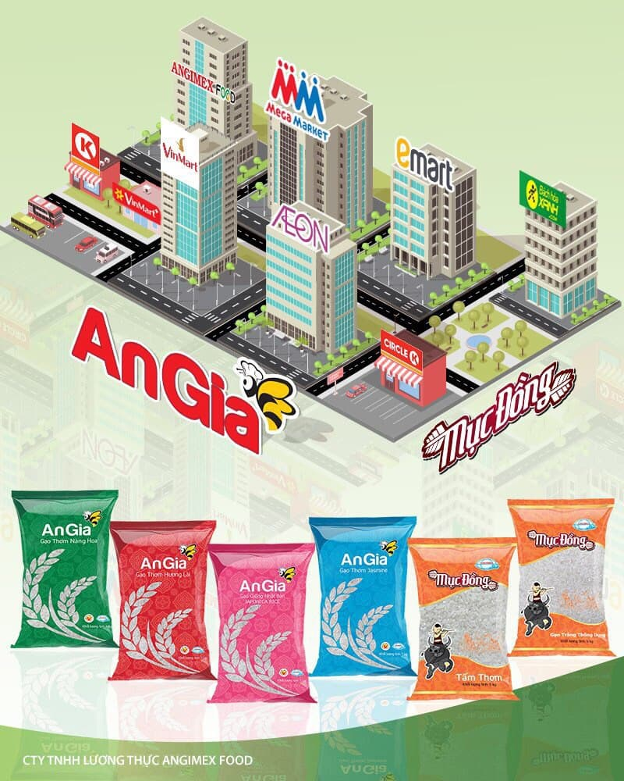
Domestic Market
Consumption:
Supply rice for industrial kitchens & horeca channel.
Supermarket systems: (Aeon, Mega Market, Emart, Bach Hoa Xanh, CircleK, etc.)
Production:
We provide the rice materials in large quantity, meeting strict microbiological standards of food manufacturing enterprises: beer, cake, flour, instant noodles, etc.
Rice types are processed according to special procedures, especially in terms of strict food safety and hygiene factors that must be assessed by customers who choose suppliers according to strict procedures.

Slide 15
Our partners
Europe market:
10 years+ experience
Annual volume:
10,000–15,000 tons.
Export partners

Slide 16
Our partners
B2B partners

Slide 17
Our partners
Partners in supermarket, convenience store

Slide 18
Contact Us
Website: www.angimex.com.vn
www.angimexfood.com
Email: rice@angimex.com.vn
Tel: (+84) 296 3 841 548

