Slide 1
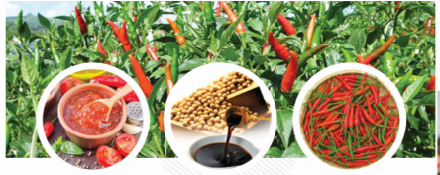
HAI NAM INDUSTRY AND
COMMERCE CO., LTD

Slide 2
Dear valued Customers and Partners,
Hai Nam Industry and Commerce Co., Ltd would like to send our best wishes to our valued Customers and Partners the best wishes for health, success, happiness and hope Value Customers and Partners and HAINAM will have a successful cooperation in the near future.
Our Company is the leading specializing n processing and supply of Chili sauce, Ketchup, Soy Sauce and Soup Powder on the production lines and the most modern equipment today, with headquarter and factory in Hai Phong, Vietnam.
The factory is located on National Highway 5, from Hai Phong Port to our factory about 5km,, very convenient for domestic and foreign delivery.

Slide 3
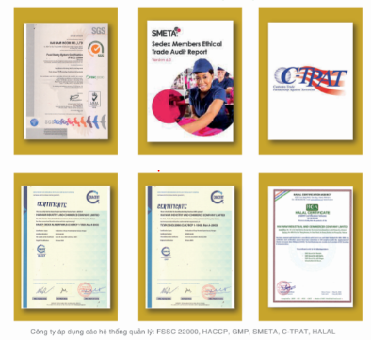
The Company has been certified with food safety management systems such as: GMP Food, HACCP Codex, FSSC 22000 Version 5 - Global Food Safety Initiative has recognized... and compliance with the regulations on Sedex Members Ethical Trade Audit - SMETA 2 PILLAR, Customs-Trade Partnership Against Terrorism - CTPAT, Halal standards...

Slide 4
The company's products have been present for decades in Europe and North America.
Come back in Vietnam, the Company introduced the Private Label products of VinMart GOOD Brand.
We now employees of experienced and creative engineers and technicians, able to develop many new products according to requirements of value Customer and meet market requirements. We would like to development HAINAM become a strong factory, having a positive influence on Vietnam's agricultural industry.
Our products are currently distributed in the markets as bellow:
* EU and Eastern Europe: supermarket systems
* North America: Costco supermarket system.
* Vietnam: Supermarkets and stores of VinMart

Slide 5
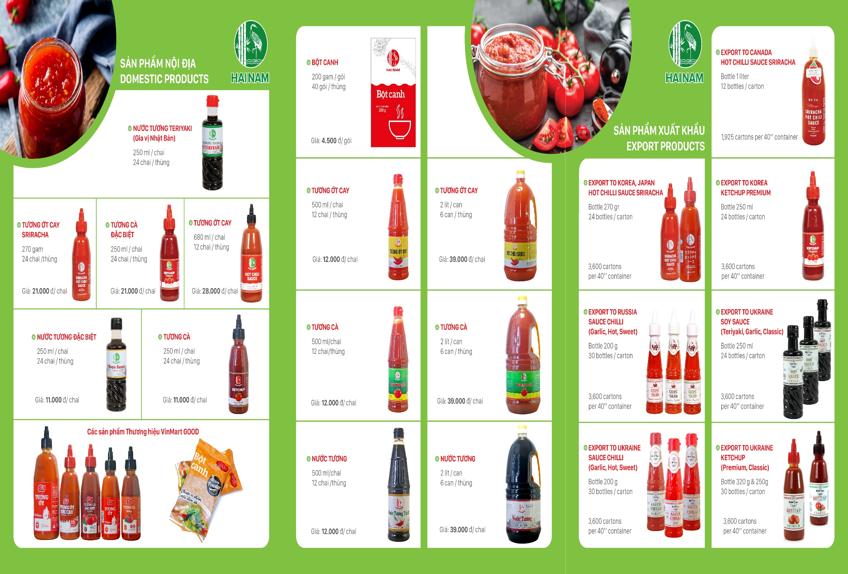
Main Producst
Notes:
We aim to surpass expectations as the world’s leading inspection, verification, testing and certification company
We are 80,000 employees, across a network of more than 1’650 offices and laboratories around the world
Today, our focus is on delivering business benefits, innovative solutions and services to help our customers: quality; safety; efficiency; productivity; speed to market; reduced risk; trust; and sustainability
We transform value chains across 13 global industries: Agriculture and Food; Automotive; Chemical; Construction; Consumer Goods and Retail; Energy; Finance; Industrial Manufacturing; Life Sciences; Logistics; Mining; Oil and Gas; and Public Sector

Slide 6
THANK YOU SO MUCH
FOR YOUR ATTENTION

